Slide 1
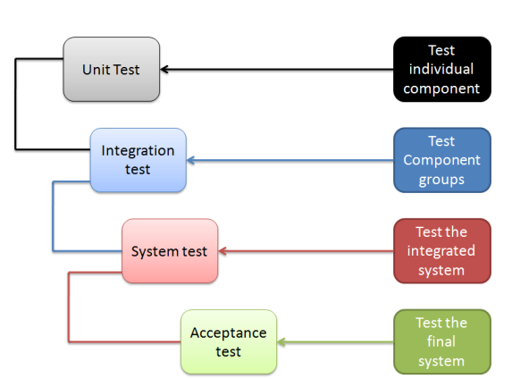
Software Testing
Notes:
19ref
http://pesona.mmu.edu.my/~wruslan/SE2/LectureNotes/ppt/19-refppt.ppt
https://www.test-institute.org/Software_Testing_Levels.php

Slide 2
https://www.guru99.com/levels-of-testing.html
http://www.cs.swan.ac.uk/~csmarkus/CS339/presentations/20061202_Oladimeji_Levels_of_Testing.pdf
https://w3softech.com/blog/levels-of-testing/

Slide 3
Lecture Objectives
Verification
Validation
Fault
Error
Software Testing
Testing Strategies
TestCase

Slide 4
Verification and Validation
Verification
refers to the set of activities that ensure that
software correctly implements a specific function.
Validation refers to set of activities that ensure that
the software that has been built is traceable to customer requirements.
(Boehm, 1981) states this another way:
Verification: "Are we building the product right?"
Validation: "Are we building the right product?"

Slide 5
Validation & Verification
Verification
“Are we building the product right ?”
Ensure software meet specification (error-free)
Validation
“Are we building the right product ?”
Ensure software meets customer’s needs

Slide 6
Terminology
Failure: Any deviation of the observed behavior from the specified behavior
Erroneous state (error): The system is in a state such that further processing by the system can lead to a failure
Fault: The coding syntax or algorithmic cause of an error (“bug”)
Validation: Activity of checking for deviations between the observed behavior of a system and its specification.

Slide 7
Examples of Faults and Errors
Faults in the Interface specification
Mismatch between what the client needs and what the application offers
(requirements and implementation)
Algorithmic Faults
Missing initialization
Incorrect branching condition
Missing test for null
Errors
Null reference errors
Concurrency errors
Exceptions.
Notes:
Beispiel Itunes
Jeder freier song

Slide 8

Software Testing
Software Testing is a process of executing a program with the intent of finding an error.
Passed test: no error was found
Failed test: an error was demonstrated.
Notes:
http://letzdotesting.com/bug-in-software-testing/

Slide 9
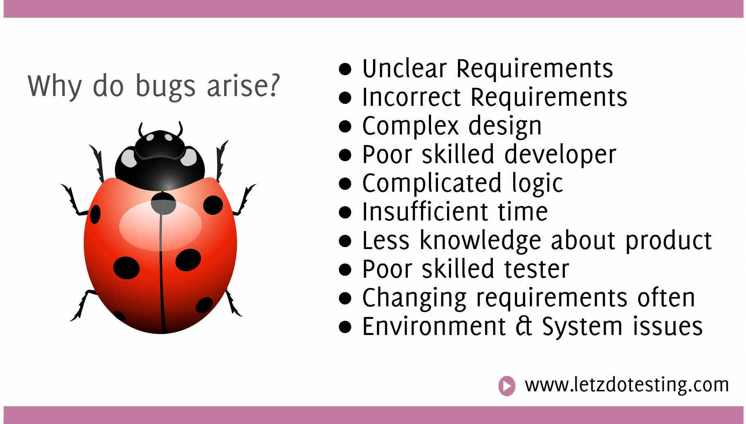
Notes:
http://letzdotesting.com/bug-in-software-testing/

Slide 10
Why Testing?
Reveal faults/failures/errors
Locate faults/failures/errors
Show system correctness
Improved confidence that system performs as specified (verification)
Improved confidence that system performs as desired (validation)
Indicator of system reliability and system quality

Slide 11
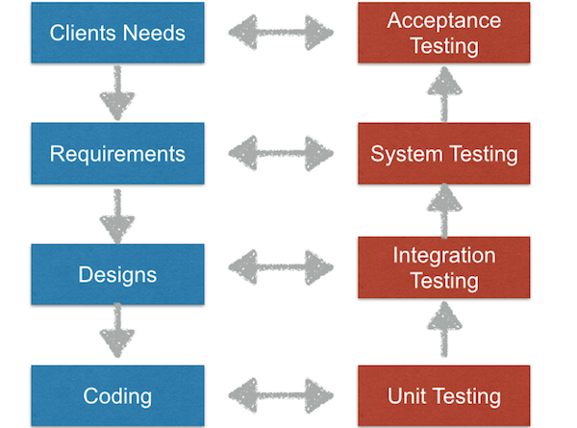
Software Testing Strategies
Unit testing
Integration testing
System testing
Acceptance testing.
http://hackingig.com/what-are-software-testing-levels/
Notes:
Outline anpassen
19ref
http://pesona.mmu.edu.my/~wruslan/SE2/LectureNotes/ppt/19-refppt.ppt

Slide 12
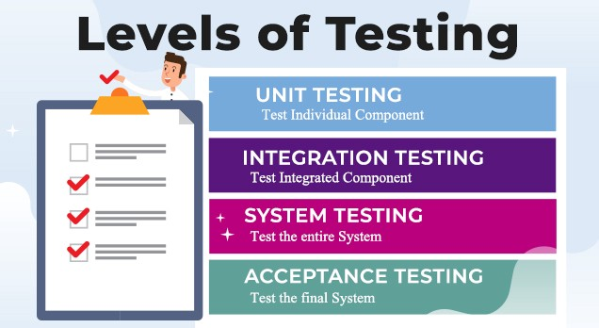
Notes:
https://medium.com/fintegro-company-inc/software-testing-levels-what-are-they-ff602cd1537c

Slide 13
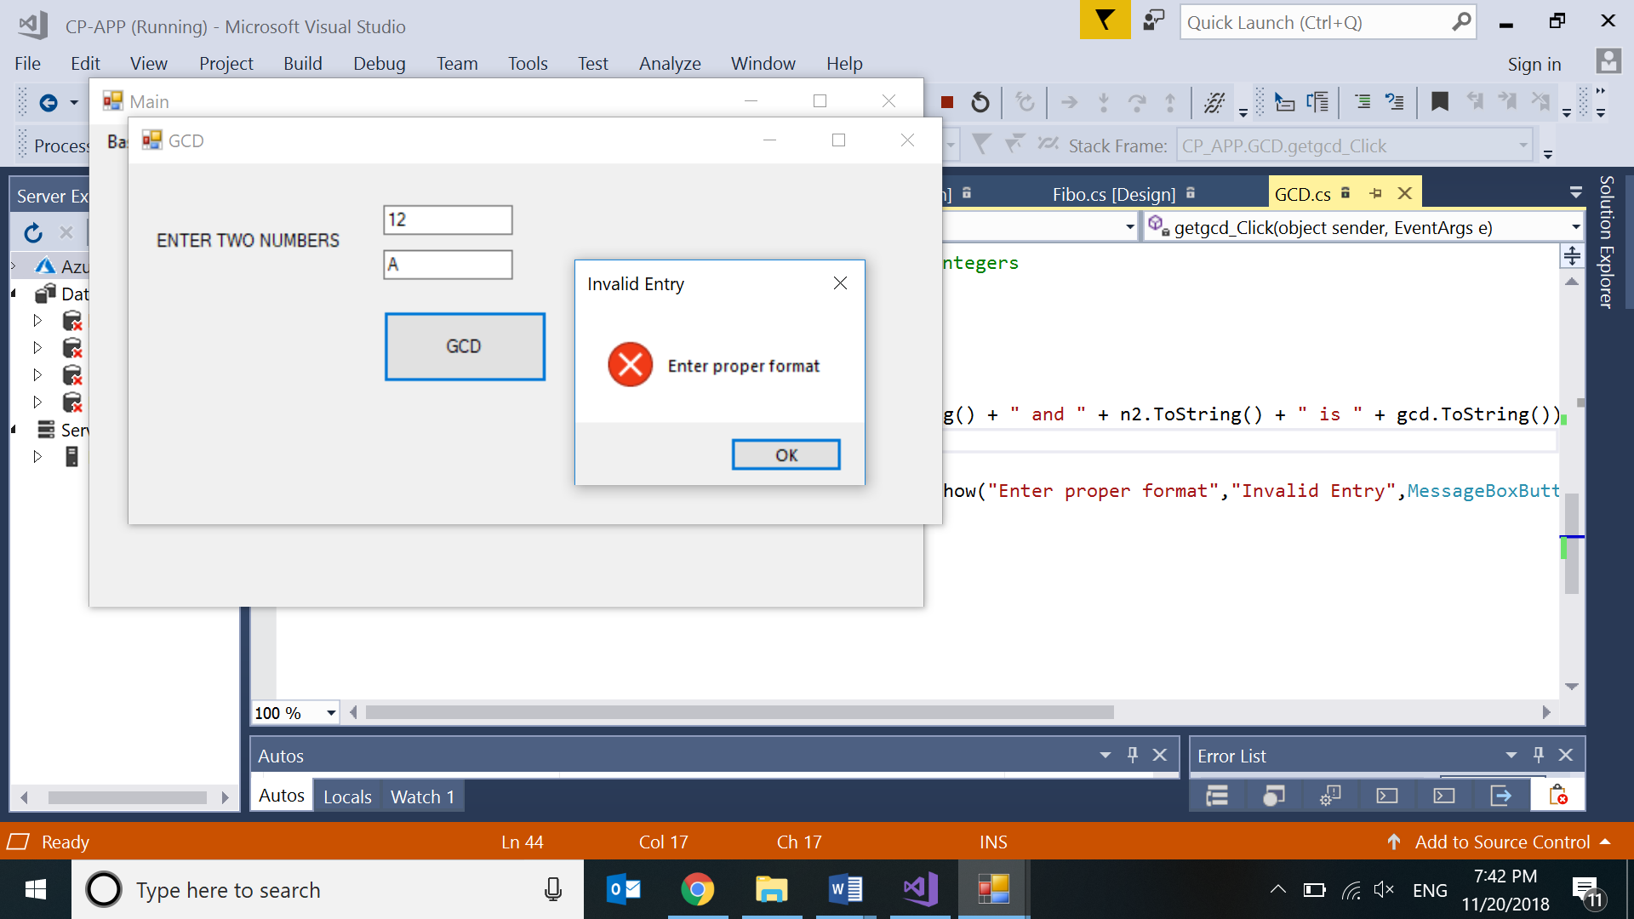
1) Unit testing:
Unit Testing
Integration Testing
System Testing
Acceptance Testing
A Unit is a smallest testable portion of a system or application which can be compiled, linked, loaded, and executed.
Individual component (class/form or subsystem) is tested
This kind of testing helps to test each module separately.
The aim is to test each part of the software by separating it.
Confirm that the component or subsystem(form) is correctly coded and carries out the intended functionality
This kind of testing is performed by developers.

Slide 14
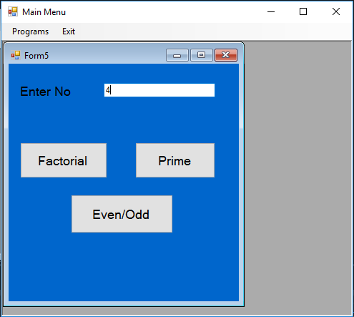
2) Integration testing:
Unit Testing
Integration Testing
System Testing
Acceptance Testing
Integration means combining.
In this testing phase, different software modules are combined and tested as a group to make sure that integrated system is ready for system testing.
Integrating testing checks the data flow from one module to other modules.
This kind of testing is performed by testers.

Slide 15
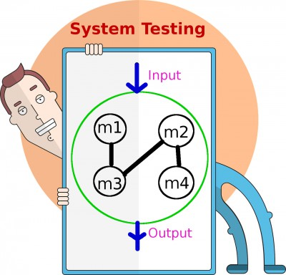
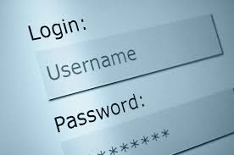
3) System testing:
Unit Testing
Integration Testing
System Testing
Acceptance Testing
System testing is performed on a complete, integrated system.
It allows checking system's compliance as per the requirements.
It tests the overall interaction of components.
It involves load, performance, reliability and security testing.
System testing is to verify that the system
meets the specification.

Slide 16
4) Acceptance testing:
Unit Testing
Integration Testing
System Testing
Acceptance Testing
Acceptance testing is a test conducted to find if the requirements of a specification or contract are met as per its delivery.
Acceptance testing is basically done by the user or customer.
However, other stockholders can be involved in this process.

Slide 17
Steps to testing
1. Develop the test cases
2. Execute the test cases
3. Compare the Actual results with the Expected results
4. If Same then Test Case Passes
5. If Different then Test Case Fails
6. For failed test case, resolve the bug and repeat that test case.
Notes:
Develop the test cases
Goal: Find minimal num- ber of test cases to cover as many paths as possible
Don’t forget regression testing
Re-execute test cases every time a change is made.

Slide 18
Test Cases
Test case : unit of testing activity
Test cases have 3 parts :-
Goal
Aspect(What part) of the system being tested
Input and system state
Data provided to the system under specific condition
Expected behavior
The output or action the system should take according to its requirements

Slide 19
Type Of Test Cases
Test cases are derived for
Valid and expected input
Invalid and unexpected input
Test if the system does less than specified requirement

Slide 20
Test Case
TestId | : | T2001
ModuleNo | : | T2-EvenOdd
TestName | : | EvenOdd- Valid_Odd_Input
Test Scenario/ Steps | : | Open Form # Enter number in the textbox txtno Click button “Check Even/Odd”.
Test Input | : | 7
Expected Result | : | Message should display “7 is Odd”
Actual Result | : | Message “7 is Odd”
Pass / Fail | : | PASS
Screenshot | :

Slide 21
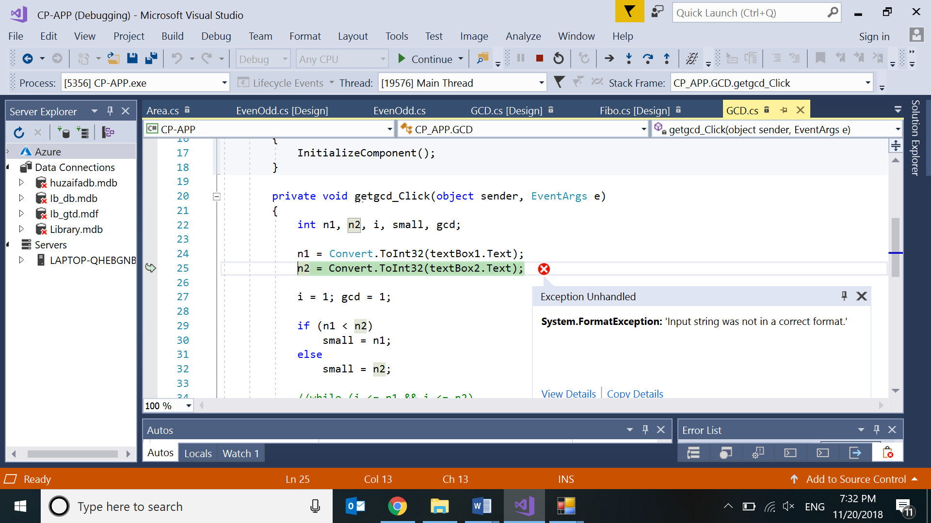
TestId | : | T4003
ModuleNo | : | T4-GCD-LCM
TestName | : | GCD- InValid_ Input
Test Scenario/ Steps | : | Open Form # Enter A in one of the textbox txtno Click button “GCD/LCM”.
Test Input | : | 4 A
Expected Result | : | Error Message should display “Enter correct format”
Actual Result | : | System exited with errors
Pass / Fail | : | FAIL
Screenshot | :

Slide 22
4.b) Analyze Test Results
No. | Test No | Module No | Module Name | Test Input Data | Expected Result | Actual Result | Pass/ Fail
1 | T1001 | T1-Multiplication | Multiplication Table- Valid_Input | 6 | Multiplication table | Multiplication table | PASS
2 | T4003 | T4-GCD-LCM | GCD-LCM InValid_Input | A | Error Message | System Crash | FAIL
3 | T2001 | T2-EvenOdd | EvenOdd- Valid_Odd_Input
4 | T2002 | T2-EvenOdd | EvenOdd- Valid_Even_Input

Slide 23
TestNo [T4003] has failed because
input datatype error handling is not performed.
The error was handled by
try catch block to handle FormatException and test was performed again.

Slide 24
TestId | : | T4003
ModuleNo | : | T4-GCD-LCM
TestName | : | GCD- InValid_ Input
Test Scenario/ Steps | : | Open Form # Enter A in one of the textbox txtno Click button “GCD/LCM”.
Test Input | : | A
Expected Result | : | Error Message should display “Enter correct format”
Actual Result | : | Error Message displayed “Enter correct format”
Pass / Fail | : | PASS
Screenshot | :

Slide 25
Testing is complete. All tests have passed. The version 1.1 is ready for release to the client.

